Slide 1

Chapter 5 – S6
How to use the CSS box model
for spacing, borders, and backgrounds
Notes:
Session: Ghi số thứ tự session trong môn học
Session Name: ghi tên của session sẽ dạy

Slide 2
Objectives
An introduction to the box model
How to size and space elements
A web page that illustrates sizing and spacing
How to set borders and backgrounds
A web page that uses borders and backgrounds
Notes:
Mô tả nội dung mà học viên phải đạt được khi kết thúc môn học này

Slide 3
An introduction to the box model

Slide 4
How the box model works
The CSS box model lets you work with the boxes that browser places around each block element as well as some inline elements.
You can add formatting such as margins, padding, and borders
Notes:
Mô tả nội dung chi tiết từng chuyên đề

Slide 5
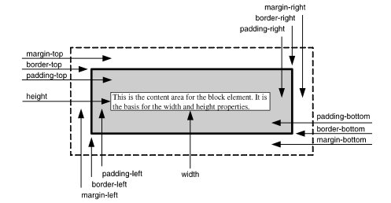
The CSS box model
Notes:
Mô tả nội dung chi tiết từng chuyên đề

Slide 6


The CSS box model
The formula for calculating the height of a box
The formula for calculating the width of a box

Slide 7
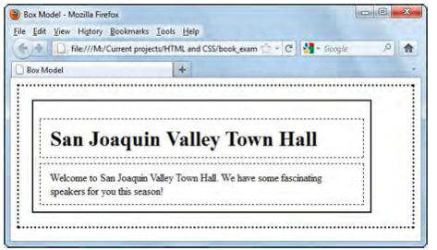
A web page that illustrates the box model
The web page in a browser

Slide 8

A web page that illustrates the box model
The HTML for a page that uses the box model

Slide 9
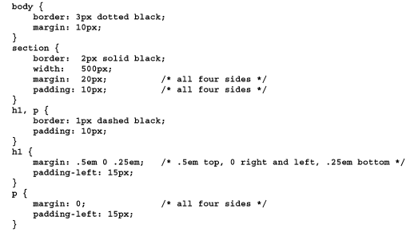
A web page that illustrates the box model
The CSS for the page

Slide 10
How to size and space elements

Slide 11
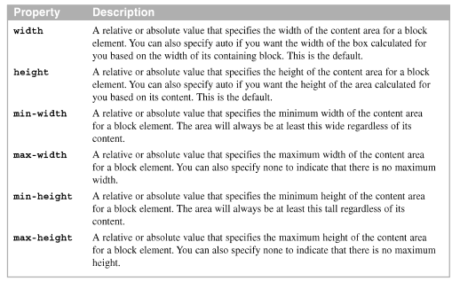
How to set heights and widths
Properties for setting heights and widths

Slide 12

How to set heights and widths
How to set the width of the content
How to set the height of the content

Slide 13
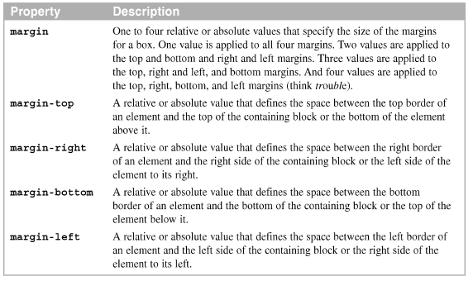
How to set margins
Properties for setting margins

Slide 14


How to set margins
How to set the margin on a single side of an element
How to set the margins on multiple sides of an element

Slide 15
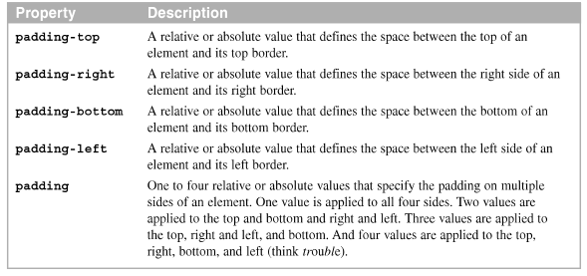
How to set padding
Properties for setting padding

Slide 16


How to set padding
How to set the padding on a single side of an element
How to set the padding on multiple sides of an element

Slide 17
A web page that illustrates sizing and spacing

Slide 18
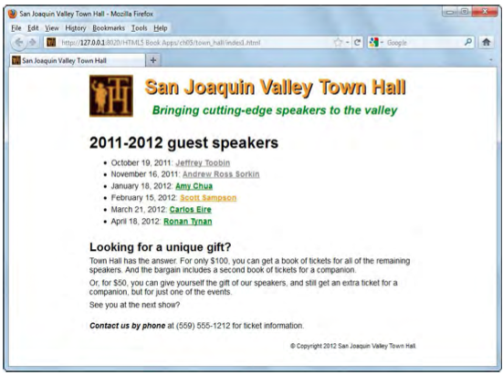
The HTML for the web page
A web page uses widths, margins, and padding

Slide 19
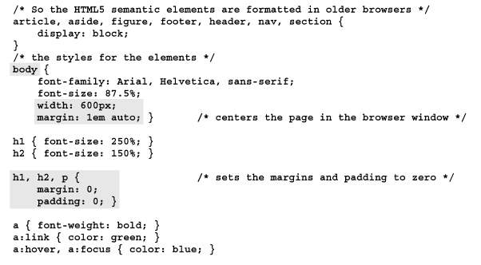
The CSS for the web page
The CSS for the web page
…

Slide 20
A version of the CSS that uses a reset selector
A slightly modified version of the page that uses a reset selector

Slide 21
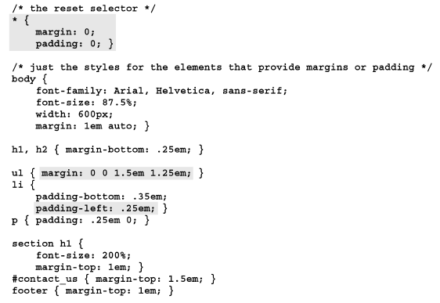

Slide 22
How to set borders and backgrounds

Slide 23
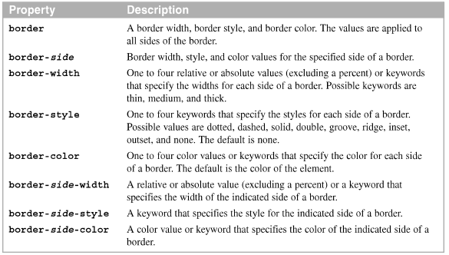
How to set borders
Properties for setting borders

Slide 24


How to set borders
The syntax for the shorthand border and border-side properties
Example

Slide 25


How to use CSS3 to add rounded corners and shadows to borders
Use the CSS3 for adding rounded corners and shadows to borders.
The syntax for the border-radius and box-shadow properties
The HTML for a section

Slide 26
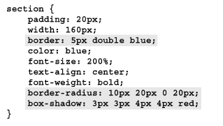

How to use CSS3 to add rounded corners and shadows to borders
The CSS for the section
The section in a browser

Slide 27
How to use CSS3 to add rounded corners and shadows to borders
Guidelines for backward compatibility
To round corners and add shadow in older versions of Firefox, you can use the -moz-border-radius and -moz-box-shadow properties
To add shadows in older version of Safari and Chrome, you can use the –webkit-box-shadow property.

Slide 28
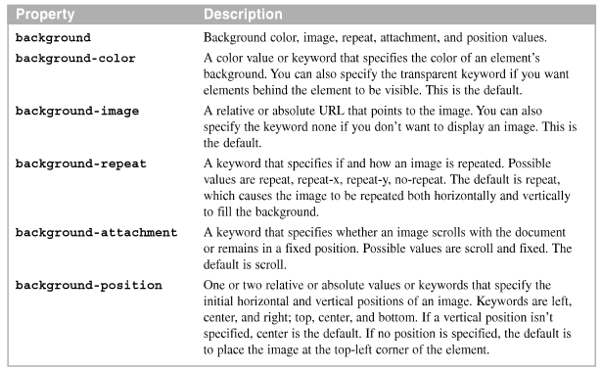
How to set background colors and image
The properties for setting the background color and image

Slide 29
How to set background colors and image
The syntax for the shorthand background property
Use the shorthand properties

Slide 30

How to use CSS3 to set background gradients
The CSS3 for linear gradients lets you create gradients for background without using image.
The syntax for using a linear gradient in the background-image property
The HTML for two divisions

Slide 31
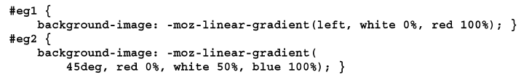
How to use CSS3 to set background gradients
The CSS for the two divisions using Mozilla prefixes(-moz-)

Slide 32
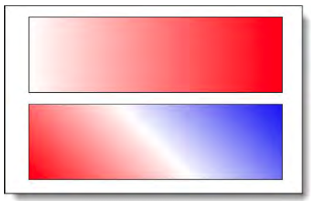
How to use CSS3 to set background gradients
The linear gradients in a browser
A background-image property that creates red, white and blue stripes

Slide 33
A web page that uses borders and backgrounds

Slide 34
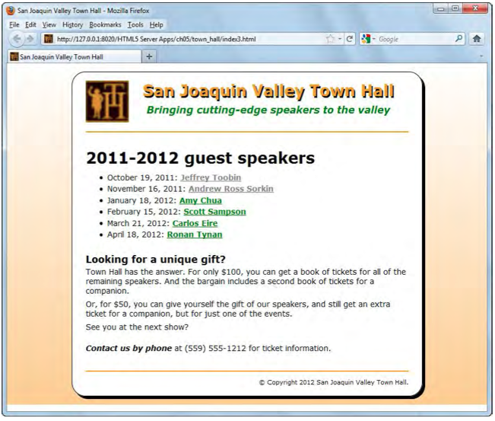
The HTML for the web page
A web page that uses borders and a background gradient

Slide 35
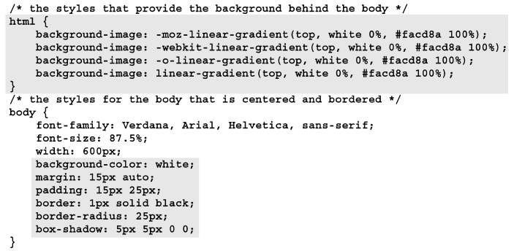
The CSS for the web page
……..

Slide 36
Summary
The CSS box model refer to the box that a browser places around each block element as well as some inline elements
Set the margin for all four sides of a box
A border can be placed on any of the sides of a box
Set the background for a box
Use CSS to round corners and add shadows to borders. Use CSS3 to provide linear gradient as background.
Notes:
Tóm tắt lại nội dung đã học

